Slide 1
What’s new in Fireware 12.7

Slide 2
What’s new in Fireware v12.7
AuthPoint Integration with a Firebox
Mobile VPN with SSL and AuthPoint Integration
Mobile VPN with IKEv2 and AuthPoint Integration
Firebox Authentication Portal and AuthPoint Integration
Fireware Web UI Integration with AuthPoint
802.1p Marking for VLAN Interfaces
DHCP Lease Count
APT Blocker – HTTP Proxy Server Settings
APT Blocker – Submit PDF Files for Analysis
Configure Log Rate Limits
HTTPS Predefined Exceptions List Automatic Updates
FQDN Limits Replaced by Warning
Intra-Bridge Traffic Inspection
Disable DNS Cache

Slide 3
WHAT’s New In Fireware v12.7
Fireware v12.7 is available for these Firebox models:
  M Series: M270, M370, M400, M440, M470, M500, M570, M670, M4600, M4800, M5600, M5800
  T Series: T20, T40, T55, T70, T80
  FireboxV and Firebox Cloud
Fireware v12.7 does not support these models:
  T10, T15, T30, T35, T50, M200, M300
  We continue to support these models with Fireware v12.5.x firmware. For more information, see this KB article
  If you installed a beta version of the Fireware v12.7 firmware on these models, follow the steps in this KB article to downgrade

Slide 4
AuthPoint Integration with a Firebox

Slide 5
Authpoint Firebox Integration
You can now use AuthPoint as an authentication server on your Firebox. This makes is easier to configure AuthPoint MFA for:
  Mobile VPN with SSL
  Mobile VPN with IKEv2
  Firebox Web UI
  Firebox Authentication Portal
With this integration, AuthPoint receives the IP address of the end user, so network location policy objects apply when a user authenticates with a VPN client
With this integration, the AuthPoint Gateway is only required to sync users from an LDAP database to AuthPoint

Slide 6
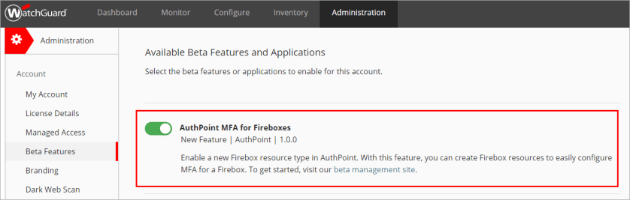
Requirements
To create Firebox resources in AuthPoint, you must enable the AuthPoint MFA for Fireboxes beta toggle in WatchGuard Cloud
  For detailed steps to enable beta features, see the WatchGuard Cloud Help

Slide 7
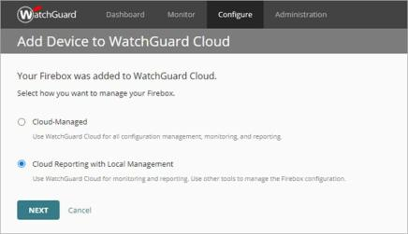
Requirements
In AuthPoint, you must configure at least one group before you can add users or authentication policies
You must register and connect your Firebox to WatchGuard Cloud as a locally-managed Firebox (this integration does not support cloud-managed Fireboxes)

Slide 8
Overview
To enable AuthPoint as an authentication server on your Firebox:
  Add your Firebox to WatchGuard Cloud as a locally-managed Firebox
  Add groups, users, and authentication policies in AuthPoint
  To sync users from an LDAP database, you must:
    Configure an external identity
    Download and install the AuthPoint Gateway
  Add a Firebox resource
  Add the Firebox resource to your authentication policies
To configure your Firebox, see the sections for Mobile VPN with SSL, Mobile VPN with IKEv2, Firebox Authentication Portal, and Fireware Web UI integrations

Slide 9
Add a Firebox Resource in AuthPoint
To add a Firebox resource in AuthPoint:
  Log in to WatchGuard Cloud and select Configure > AuthPoint
  From the navigation menu, select Resources
  From the Choose a Resource Type drop-down list, select Firebox
  Click Add Resource
  Type a name to identify this resource
  From the Firebox drop-down list, select the Firebox that you want to connect to AuthPoint (this list only shows Fireboxes that you have added to WatchGuard Cloud)
  Save your resource. The AuthPoint authentication server on your Firebox is enabled

Slide 10
Existing Integrations
If you have already configured AuthPoint MFA for your Firebox:
  In AuthPoint, add a Firebox resource for your Firebox and configure an authentication policy for the new resource
  In Fireware, configure AuthPoint as the primary authentication server for your Mobile VPN with SSL or Mobile VPN with IKEv2 configuration
  Test MFA with the new configuration
  Delete your previous configuration:
    In AuthPoint, delete the existing RADIUS client resource and remove the RADIUS client resource from your Gateway
    In Fireware, delete the RADIUS server you configured for the AuthPoint Gateway

Slide 11
Existing Integrations
In Fireware v12.7, you cannot name new authentication servers “AuthPoint”
If you have an existing authentication server called AuthPoint, that authentication server will be automatically renamed to “AuthPoint.1” when you:
  Upgrade your Firebox to Fireware v12.7
  Use WSM or Policy Manager v12.7 or higher to manage a Firebox that runs Fireware 12.6.x or lower
If your existing AuthPoint RADIUS authentication server is renamed and it is not the default authentication server, users must type the new authentication server name (AuthPoint.1) when they log in and use that authentication server

Slide 12
Help References
For detailed steps to configure AuthPoint, see the AuthPoint Help:
  Add a Group
  About AuthPoint Authentication Policies
  Add Local AuthPoint Users
  Sync Users from Active Directory or LDAP
If you are new to AuthPoint, the AuthPoint Deployment Guide covers all the steps required for a complete AuthPoint deployment

Slide 13
Mobile VPN with SSL and AuthPoint integration

Slide 14
Mobile VPN with SSL and AuthPoint
You can now configure Mobile VPN with SSL to authenticate mobile VPN users directly through AuthPoint

Slide 15
Mobile VPN with SSL and AuthPoint Integration
When you configure Mobile VPN with SSL for direct AuthPoint authentication:
  Firebox forwards SSL VPN user authentication requests directly to AuthPoint
  AuthPoint coordinates multi-factor authentication (MFA):
    Local users: AuthPoint validates the first factor (password) and the second factor (push or one-time password)
    LDAP users: AuthPoint tells the Firebox to contact Active Directory to validate the first factor (password); AuthPoint validates the second factor (push or one-time password)
  SSL VPN client prompts the user:
    If the user selects the push option, AuthPoint sends a push request to the user’s phone
    If the user selects the one-time password option, the SSL VPN client prompts the user to specify a one-time password (OTP)

Slide 16
Mobile VPN with SSL and AuthPoint Integration
Supported VPN clients:
  WatchGuard Mobile VPN with SSL for Windows
  WatchGuard Mobile VPN with SSL for macOS
  OpenVPN
Supported user types:
  Local
  LDAP/Active Directory
Supported MFA types:
  One-time password (OTP)
  Push

Slide 17
Mobile VPN with SSL and AuthPoint Integration
Authentication workflow (local users)
  User initiates a VPN connection from an SSL VPN client to the Firebox
  Firebox forwards the request to AuthPoint
  AuthPoint verifies the user is local and has a valid MFA policy
  AuthPoint sends a push notification to the user's mobile phone
  User receives and approves the push notification
  AuthPoint receives the push approval and tells the Firebox the push was approved
  Firebox receives the approval and allows the user to connect to the VPN

Slide 18
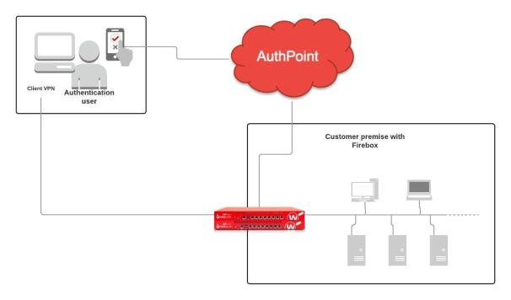
Mobile VPN with SSL and AuthPoint Integration
Topology (local users)

Slide 19
Mobile VPN with SSL and AuthPoint Integration
Authentication workflow (LDAP users)
  User initiates a VPN connection from an SSL VPN client to the Firebox
  Firebox forwards the request to AuthPoint in WatchGuard Cloud
  AuthPoint Cloud determines whether the user is an Active Directory user
  AuthPoint communicates to the Firebox that the Active Directory server must validate the user
  Firebox sends the user’s credentials to the Active Directory server (LDAP bind request)
  Active Directory validates the user credentials and responds to the Firebox
  Firebox sends an MFA request to AuthPoint
  AuthPoint verifies the user has a valid MFA policy
  Continued on the next slide

Slide 20
Mobile VPN with SSL and AuthPoint Integration
  For Push:
    AuthPoint sends a push notification to the user's mobile phone
    User receives and approves the push notification
    AuthPoint receives the push approval and contacts the Firebox
    Firebox receives the approval and allows the user to connect to the VPN
  For OTP:
    AuthPoint validates the OTP
    Firebox receives the approval and allows the user to connect to the VPN

Slide 21
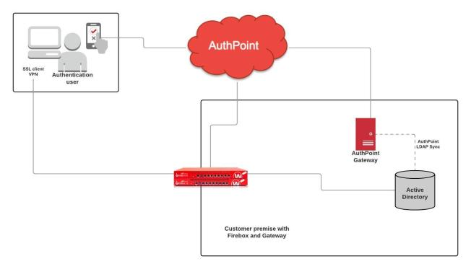
Mobile VPN with SSL and AuthPoint Integration
Topology (LDAP users)

Slide 22
Mobile VPN with SSL and AuthPoint Integration
Configuration
  Before you begin, register and connect your Firebox to WatchGuard Cloud
    Select the Cloud Reporting with Local Management option (this integration does not support cloud-managed Fireboxes)
    For detailed WatchGuard Cloud instructions, see Fireware Help
  Configure the required AuthPoint settings before you configure Mobile VPN with SSL to use AuthPoint as an authentication server
    This section includes a brief summary of required AuthPoint settings. For detailed AuthPoint instructions, see the AuthPoint section in this presentation

Slide 23
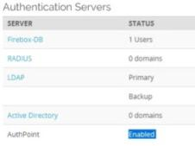
Mobile VPN with SSL and AuthPoint Integration
Configuration
  In AuthPoint:
    Add groups, users, and authentication policies if you have not done so already
    Add the Firebox as a resource
    After you complete this step, AuthPoint is automatically enabled in the Authentication Servers list on your Firebox

Slide 24
Mobile VPN with SSL and AuthPoint Integration
Configuration
  In AuthPoint (continued):
    Add the Firebox resource to your authentication policies

Slide 25
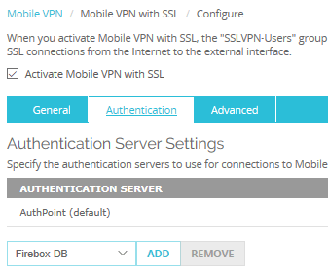
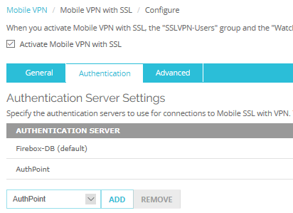
Mobile VPN with SSL and AuthPoint Integration
Configuration
  In the Mobile VPN with SSL configuration on the Firebox:
    Select AuthPoint as an authentication server
Example 1: AuthPoint as the default authentication server
Example 2: AuthPoint as a non-default authentication server

Slide 26
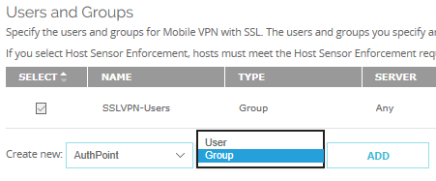
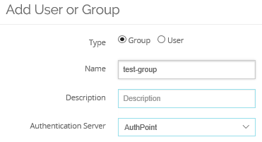
Mobile VPN with SSL and AuthPoint Integration
Configuration
  In the Mobile VPN with SSL configuration (continued)
    You can specify AuthPoint as the authentication server for new SSL VPN users and groups

Slide 27
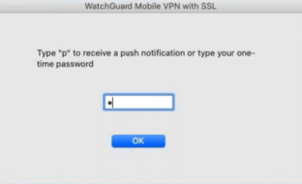
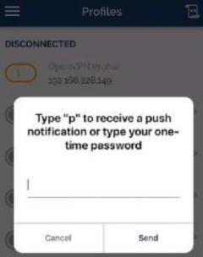
Mobile VPN with SSL and AuthPoint Integration
SSL VPN clients
  When a user tries to connect to Mobile VPN with SSL, the client prompts the user to select an MFA option:
WatchGuard client
OpenVPN client

Slide 28
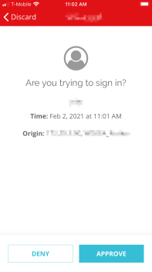
Mobile VPN with SSL and AuthPoint Integration
Mobile VPN with SSL client
    If the user types “p” or “P,” AuthPoint sends a push request to the user’s phone
    Otherwise, the user can type a one-time password

Slide 29
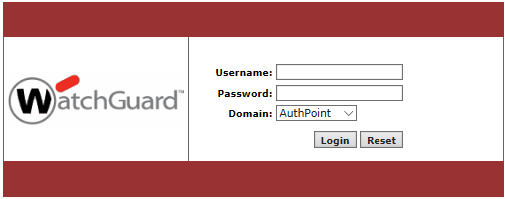
Mobile VPN with SSL and AuthPoint Integration
Mobile VPN with SSL software downloads page
  If you select AuthPoint as one of the authentication servers for Mobile VPN with SSL, users can select AuthPoint to log on to the Mobile VPN with SSL software downloads page

Slide 30
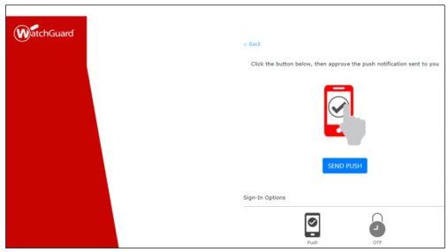
Mobile VPN with SSL and AuthPoint Integration
Mobile VPN with SSL software downloads page
  If you select AuthPoint as the domain, or if AuthPoint is the only authentication server specified in the Mobile VPN with SSL configuration, an MFA options page appears
  Push:

Slide 31
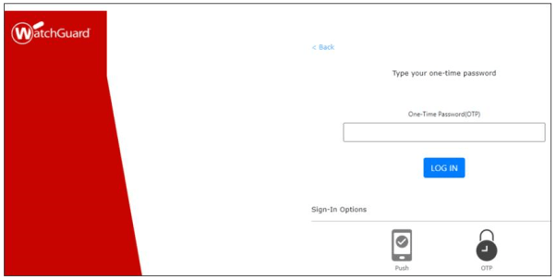
Mobile VPN with SSL and AuthPoint Integration
Mobile VPN with SSL software downloads page
  One-time password:

Slide 32
Mobile VPN with SSL and AuthPoint Integration
Update an existing integration
  If you configured Mobile VPN with SSL for AuthPoint MFA before Fireware v12.7, you can keep that integration in place while you configure an updated integration
  For more information, see the AuthPoint section in this presentation

Slide 33
Mobile VPN with SSL and AuthPoint Integration
Unsupported features
  This configuration does not support:
    Cloud-managed Fireboxes
    QR codes
    Auto-reconnect for Mobile VPN with SSL clients

Slide 34
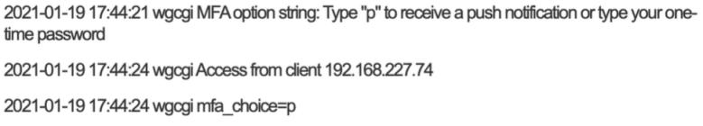
Mobile VPN with SSL and AuthPoint Integration
Firebox Log Files
  To see log messages for events that occur between the Firebox and WatchGuard Cloud, search for admd and daas in Traffic Monitor
  To see log messages for events that occur between the mobile VPN and authentication services on the Firebox, search for wgcgi in Traffic Monitor

Slide 35
Mobile VPN with IKEv2 and AuthPoint integration

Slide 36
Mobile VPN with IKEv2 and AuthPoint
You can now configure Mobile VPN with IKEv2 to authenticate mobile VPN users directly through AuthPoint
  This integration supports MS-CHAPv2 authentication for Active Directory users

Slide 37
Mobile VPN with IKEv2 and AuthPoint Integration
When you configure Mobile VPN with IKEv2 for direct AuthPoint authentication:
  Firebox forwards IKEv2 VPN user authentication requests directly to AuthPoint
  AuthPoint coordinates multi-factor authentication:
    Local users: AuthPoint validates the first factor (password) and the second factor (push notification)
    LDAP users: AuthPoint tells the Firebox to contact NPS to validate the first factor (password); AuthPoint validates the second factor (push notification)

Slide 38
Mobile VPN with IKEv2 and AuthPoint Integration
Supported VPN clients:
  Native IKEv2 VPN clients (Windows, iOS, macOS)
  strongSwan
Supported user types:
  Local
  LDAP/Active Directory
Supported MFA type:
  Push

Slide 39
Mobile VPN with IKEv2 and AuthPoint Integration
Authentication workflow (local users)
  User initiates a Mobile VPN with IKEv2 connection
  Firebox forwards the request to AuthPoint
  AuthPoint verifies the user is local and has a valid multi-factor authentication (MFA) policy
  AuthPoint sends a push notification to the user's mobile phone
  User receives and approves the push notification
  AuthPoint receives the push approval and tells the Firebox the push was approved
  Firebox receives the approval and allows the user to connect the VPN

Slide 40
Mobile VPN with IKEv2 and AuthPoint Integration
Topology (local users)

Slide 41
Mobile VPN with IKEv2 and AuthPoint Integration
How it works (LDAP/Active Directory users)
  User initiates a VPN connection from an IKEv2 VPN client to the Firebox
  Firebox forwards the request to AuthPoint in WatchGuard Cloud
  AuthPoint Cloud determines whether the user is an Active Directory user
  AuthPoint communicates to the Firebox that the NPS server must validate the user
  Firebox sends the user’s credentials to NPS for validation (RADIUS protocol). NPS is required for Active Directory users who log in from an IKEv2 client
  NPS responds to the Firebox
  Continued on the next slide

Slide 42
Mobile VPN with IKEv2 and AuthPoint Integration
  Firebox sends an MFA request to AuthPoint
  AuthPoint verifies the user has a valid MFA policy
  AuthPoint sends a push notification to the user's mobile phone
  User receives and approves the push notification
  AuthPoint receives the push approval and contacts the Firebox
  Firebox receives the approval and allows the user to connect the VPN

Slide 43
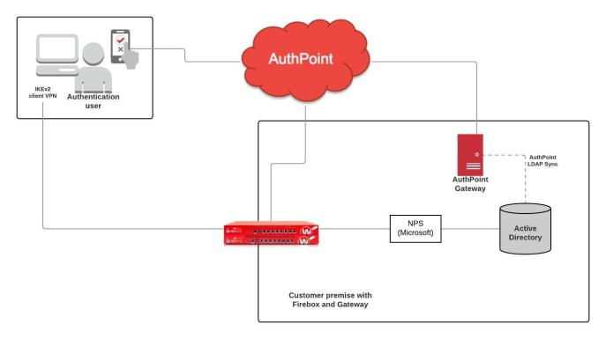
Mobile VPN with IKEv2 and AuthPoint Integration

Slide 44
Mobile VPN with IKEv2 and AuthPoint Integration
Configuration
  Before you begin, register and connect your Firebox to WatchGuard Cloud
    Select the Cloud Reporting with Local Management option (this integration does not support cloud-managed Fireboxes)
    For detailed WatchGuard Cloud instructions, see Fireware Help
  Configure the required AuthPoint settings before you configure Mobile VPN with IKEv2 to use AuthPoint as an authentication server
    This presentation includes a brief summary of required AuthPoint settings. For detailed AuthPoint instructions, see the AuthPoint section in this presentation

Slide 45
Mobile VPN with IKEv2 and AuthPoint Integration
Configuration
  In AuthPoint:
    Add groups, users, and authentication policies if you have not done so already
    Add the Firebox as a resource
    Enable the MS-CHAPv2 option and specify NPS server information
    After you add the Firebox as a resource, AuthPoint is automatically enabled in the Authentication Servers list on your Firebox

Slide 46
Mobile VPN with IKEv2 and AuthPoint Integration
Configuration
  In AuthPoint (continued):
    Add the Firebox resource to your authentication policies

Slide 47
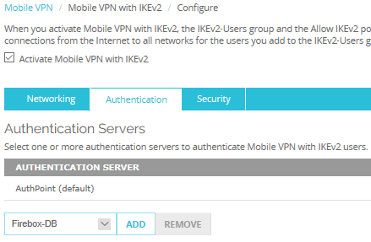
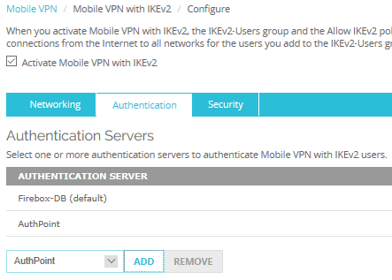
Mobile VPN with IKEv2 and AuthPoint Integration
Configuration
  In the Mobile VPN with IKEv2 configuration on the Firebox:
    Select AuthPoint as an authentication server
Example 1: AuthPoint as the default authentication server
Example 2: AuthPoint as a non-default authentication server

Slide 48
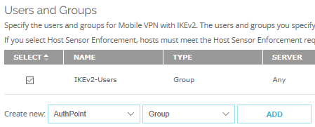
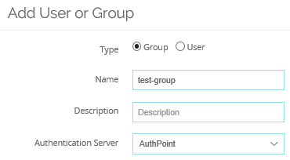
Mobile VPN with IKEv2 and AuthPoint Integration
Configuration
  In the Mobile VPN with IKEv2 configuration (continued)
    You can specify AuthPoint as the authentication server for new IKEv2 VPN users and groups

Slide 49
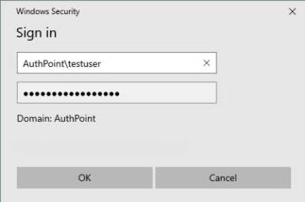
Mobile VPN with IKEv2 and AuthPoint Integration
IKEv2 VPN clients
  User specifies credentials in the IKEv2 client
    If AuthPoint is the default authentication server for Mobile VPN with IKEv2, the user can type the user name only
    If AuthPoint is not the default authentication server, the user must specify the domain name before the user name

Slide 50
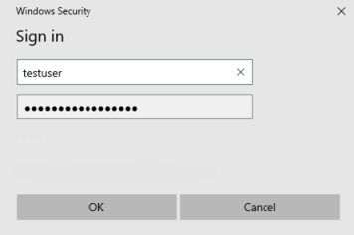
Mobile VPN with IKEv2 and AuthPoint Integration
IKEv2 client
  After a user initiates a VPN connection from an IKEv2 VPN client, the user receives a push notification

Slide 51
Mobile VPN with IKEv2 and AuthPoint Integration
Update an existing integration
  If you configured Mobile VPN with IKEv2 for AuthPoint MFA before Fireware v12.7, you can keep that integration in place while you configure an updated integration
  For more information, see the AuthPoint section in this presentation

Slide 52
Mobile VPN with IKEv2 and AuthPoint Integration
Unsupported features
  This configuration does not support:
    Cloud-managed Fireboxes
    Auto-reconnect for VPN clients
    One-time passwords
    QR codes

Slide 53
Mobile VPN with IKEv2 and AuthPoint Integration
Firebox Log Files
  To see log messages for events that occur between the Firebox and WatchGuard Cloud, search for admd and daas in Traffic Monitor
  To see log messages for events that occur between the mobile VPN and authentication services on the Firebox, search for wgcgi in Traffic Monitor

Slide 54
Firebox Authentication Portal and AuthPoint Integration

Slide 55
Firebox Authentication Portal and Authpoint
You can now use AuthPoint as an authentication server on your Firebox
  This makes is easier to configure AuthPoint MFA for the Firebox Authentication Portal
  You can now configure the Firebox Authentication Portal to authenticate users directly through AuthPoint

Slide 56
Firebox Authentication Portal and Authpoint Integration
When you configure the Firebox Authentication Portal for direct AuthPoint authentication:
  Firebox forwards user authentication requests directly to AuthPoint
  AuthPoint coordinates multi-factor authentication (MFA):
    Local users: AuthPoint validates the first factor (password) and the second factor (push or one-time password)
    LDAP users: AuthPoint tells the Firebox to contact Active Directory to validate the first factor (password); AuthPoint validates the second factor (push or one-time password)
  The Firebox Authentication Portal prompts the user:
    If the user selects the push option, AuthPoint sends a push request to the user’s phone
    If the user selects the one-time password option, the Authentication Portal prompts the user to specify a one-time password (OTP)

Slide 57
Firebox Authentication Portal and Authpoint Integration
Supported user types:
  Local
  LDAP/Active Directory
Supported MFA types:
  One-time password (OTP)
  Push

Slide 58
Firebox Authentication Portal and Authpoint Integration
Authentication workflow (local users)
  User connects to the Firebox Authentication Portal on port 4100
  User provides credentials and selects the AuthPoint authentication domain
  Firebox forwards the request to AuthPoint
  AuthPoint verifies the user is local and has a valid multi-factor authentication (MFA) policy
  User is presented with an authentication page that shows the available authentication methods
  Continued on the next slide

Slide 59
Firebox Authentication Portal and Authpoint Integration
Authentication workflow (local users)
  User selects an authentication method
  Firebox sends an MFA request to AuthPoint
    For Push:
      AuthPoint sends a push notification to the user's mobile phone
      User receives and approves the push notification
      AuthPoint receives the push approval and contacts the Firebox
      Firebox receives the approval and allows the user to log in
    For OTP:
      AuthPoint validates the OTP
      Firebox receives the approval and allows the user to log in

Slide 60
Firebox Authentication Portal and Authpoint Integration
Authentication workflow (LDAP users)
  User connects to the Firebox Authentication Portal on port 4100
  User provides credentials and selects the AuthPoint authentication domain
  Firebox forwards the request to AuthPoint
  AuthPoint, through the AuthPoint Gateway, verifies the user is an Active Directory user and the user has a valid MFA policy
  AuthPoint communicates to the Firebox that the Active Directory server must validate the user
  Firebox sends the user’s credentials to the Active Directory server (LDAP bind request)
  Active Directory validates the user credentials and responds to the Firebox
  User is presented with an authentication page that shows the available authentication methods
  Continued on the next slide

Slide 61
Firebox Authentication Portal and Authpoint Integration
Authentication workflow (LDAP users)
  User selects an authentication method
  Firebox sends an MFA request to AuthPoint
    For Push:
      AuthPoint sends a push notification to the user's mobile phone
      User receives and approves the push notification
      AuthPoint receives the push approval and contacts the Firebox
      Firebox receives the approval and allows the user to log in
    For OTP:
      AuthPoint validates the OTP
      Firebox receives the approval and allows the user to log in

Slide 62
Configuration
  Before you begin, register and connect your Firebox to WatchGuard Cloud
    Select the Cloud Reporting with Local Management option (this integration does not support cloud-managed Fireboxes)
    For detailed WatchGuard Cloud instructions, see Fireware Help
  Configure the required AuthPoint settings before you configure your users and groups on the Firebox to use AuthPoint as an authentication server
    This section includes a brief summary of required AuthPoint settings. For detailed AuthPoint instructions, see the AuthPoint section in this presentation

Slide 63
Configuration
  In AuthPoint:
    Add groups, users, and authentication policies if you have not done so already
    Add the Firebox as a resource
    After you complete this step, AuthPoint is automatically enabled in the Authentication Servers list on your Firebox
    Add the Firebox resource to your authentication policies

Slide 64
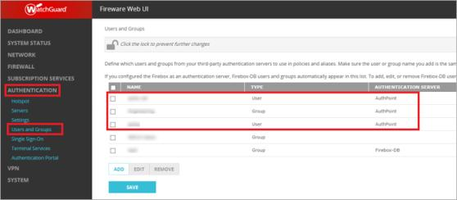
Configuration
  In the Users and Groups configuration on your Firebox:
    You can specify AuthPoint as the authentication server for new users and groups
    You can edit your existing users and groups to specify AuthPoint as the authentication server

Slide 65
Fireware Web UI Integration with AuthPoint

Slide 66
Fireware Web UI and Authpoint
You can now use AuthPoint as an authentication server on your Firebox
  This makes is easier to configure AuthPoint MFA for Firebox device management users that connect to Fireware Web UI
  You can now configure the Firebox to authenticate users directly through AuthPoint

Slide 67
Fireware Web UI and Authpoint Integration
When you configure AuthPoint as an authentication server for Firebox device management users that connect to Fireware Web UI:
  Firebox forwards user authentication requests directly to AuthPoint
  AuthPoint coordinates multi-factor authentication (MFA):
    Local users: AuthPoint validates the first factor (password) and the second factor (push or one-time password)
    LDAP users: AuthPoint tells the Firebox to contact Active Directory to validate the first factor (password); AuthPoint validates the second factor (push or one-time password)
  The Firebox prompts the user:
    If the user selects the push option, AuthPoint sends a push request to the user’s phone
    If the user selects the one-time password option, the Firebox prompts the user to specify a one-time password (OTP)

Slide 68
Fireware Web UI and Authpoint Integration
Supported user types:
  Local
  LDAP/Active Directory
Supported MFA types:
  One-time password (OTP)
  Push

Slide 69
Fireware Web UI and Authpoint Integration
Authentication workflow (local users)
  User connects to Firebox Web UI
  User provides credentials and selects the AuthPoint authentication domain
  Firebox forwards the request to AuthPoint
  AuthPoint verifies the user is local and has a valid multi-factor authentication (MFA) policy
  User is presented with an authentication page that shows the available authentication methods
  Continued on the next slide

Slide 70
Fireware Web UI and Authpoint Integration
Authentication workflow (local users)
  User selects an authentication method
  Firebox sends an MFA request to AuthPoint
    For Push:
      AuthPoint sends a push notification to the user's mobile phone
      User receives and approves the push notification
      AuthPoint receives the push approval and contacts the Firebox
      Firebox receives the approval and allows the user to log in
    For OTP:
      AuthPoint validates the OTP
      Firebox receives the approval and allows the user to log in

Slide 71
Fireware Web UI and Authpoint Integration
Authentication workflow (LDAP users)
  User connects to Firebox Web UI
  User provides credentials and selects the AuthPoint authentication domain
  Firebox forwards the request to AuthPoint
  AuthPoint, through the AuthPoint Gateway, verifies the user is an Active Directory user and the user has a valid MFA policy
  AuthPoint communicates to the Firebox that the Active Directory server must validate the user
  Firebox sends the user’s credentials to the Active Directory server (LDAP bind request)
  Active Directory validates the user credentials and responds to the Firebox
  User is presented with an authentication page that shows the available authentication methods
  Continued on the next slide

Slide 72
Fireware Web UI and Authpoint Integration
Authentication workflow (LDAP users)
  User selects an authentication method
  Firebox sends an MFA request to AuthPoint
    For Push:
      AuthPoint sends a push notification to the user's mobile phone
      User receives and approves the push notification
      AuthPoint receives the push approval and contacts the Firebox
      Firebox receives the approval and allows the user to log in
    For OTP:
      AuthPoint validates the OTP
      Firebox receives the approval and allows the user to log in

Slide 73
Configuration
  Before you begin, register and connect your Firebox to WatchGuard Cloud
    Select the Cloud Reporting with Local Management option (this integration does not support cloud-managed Fireboxes)
    For detailed WatchGuard Cloud instructions, see Fireware Help
  Configure the required AuthPoint settings before you configure your users and groups on the Firebox to use AuthPoint as an authentication server
    This section includes a brief summary of required AuthPoint settings. For detailed AuthPoint instructions, see the AuthPoint section in this presentation

Slide 74
Configuration
  In AuthPoint:
    Add groups, users, and authentication policies if you have not done so already
    Add the Firebox as a resource
    After you complete this step, AuthPoint is automatically enabled in the Authentication Servers list on your Firebox
    Add the Firebox resource to your authentication policies

Slide 75
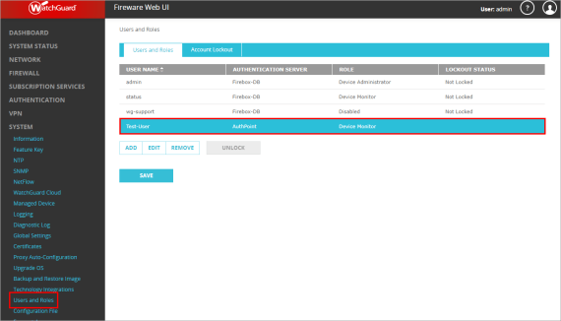
Configuration
  On the Firebox, go to System > Users and Roles and add Device Management users with AuthPoint as the authentication server

Slide 76
802.1p Marking for VLAN Interfaces

Slide 77
802.1p Marking for VLAN Interfaces
You can now enable 802.1p priority marking (tagging) for VLAN interfaces on your Firebox
  802.1p is a quality of service (QoS)/class of service (CoS) method that operates at the MAC layer (Layer 2)
  Equipment that supports 802.1p can add and recognize a value that indicates the priority level of the Ethernet frame
  802.1p can help to ensure a high level of quality for real-time communications that are sensitive to latency, such as VoIP
    The Firebox and other 802.1p-enabled equipment prioritize traffic based on the priority value

Slide 78
802.1p Marking for VLAN Interfaces
802.1p applies to only VLAN member interfaces that are configured to send and receive VLAN-tagged traffic
  This includes outbound traffic that originates from the Firebox and also outbound traffic that travels through the Firebox

Slide 79
802.1p Marking for VLAN Interfaces
When you enable 802.1p for a VLAN interface, the Firebox marks outbound traffic from that interface
  Firebox adds an 802.1q tag to Layer 2 Ethernet frames
  Firebox copies the IP precedence value from the Layer 3 IP header to the priority code point (PCP) 802.1p field in 802.1q tag

Slide 80
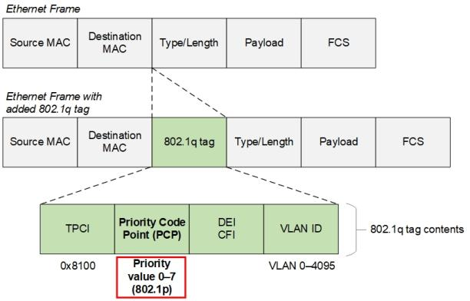
802.1p Marking for VLAN Interfaces
802.1q and 802.1p at Layer 2

Slide 81
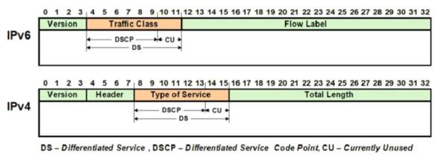
802.1p Marking for VLAN Interfaces
Differentiated Services Code Point (DSCP) value in IP packets maps to the PCP value:
  IPv6 packets — Upper three bits of the DSCP value in the Traffic Class (TC) field maps to the PCP
  IPv4 packets — Upper three bits of the DSCP value in the Type of Service (ToS) field maps to the PCP

Slide 82
802.1p Marking for VLAN Interfaces
DSCP value comprises 6 bits (0–63)
DSCP to 802.1p map:
DSCP Value Range (Layer 3 packet) | 802.1p PCP Value (Layer 2 frame)
0–7 | 0 Best effort
8–15 | 1 Background
16–23 | 2 Spare
24–31 | 3 Excellent effort
32–39 | 4 Controlled load
40–47 | 5 Video (<100ms latency)
48–55 | 6 Voice (<10ms latency)
56–63 | 7 Network control

Slide 83

802.1p Marking for VLAN Interfaces
Example
  To mark outbound VoIP traffic on a VLAN interface with a PCP value of 6, the Firebox copies the DSCP value from the packet to the 3-bit PCP 802.1p field in 802.1q tag of the frame
    DSCP of the ToS field (IPv4) or TC field (IPv6) field is 48 (110000)
    Firebox sets the PCP value to 6 (110 = 6)

Slide 84
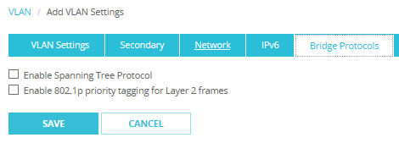
802.1p Marking for VLAN Interfaces
Configuration
  In a VLAN configuration, select VLAN > Bridge Protocols
  Select the Enable 802.1p priority tagging for Layer 2 frames check box

Slide 85
DHCP Lease Count

Slide 86
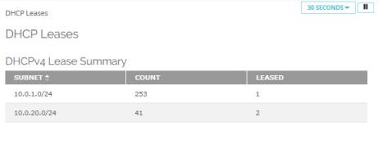
DHCP Lease Count
In Fireware Web UI, you can now see the total number of DHCP leases included in each IPv4 DHCP range configured on the Firebox
You can also see how many of those leases are in use
Select System Status > DHCP Leases
Total number of leases in the range
Number of leases in use
DHCP ranges (examples: interface DHCP server; wireless access point DHCP server)

Slide 87
APT Blocker – HTTP PROXY SERVER

Slide 88
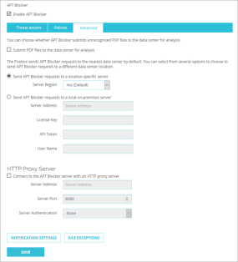
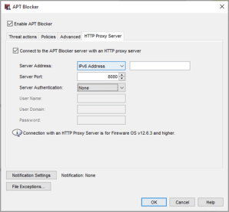
APT Blocker – HTTP Proxy Server Settings
You can now connect to the APT Blocker server with an HTTP proxy server
  In Web UI, select Subscription Services > APT Blocker > Advanced tab
  In Policy Manager, select Subscription Services > APT Blocker > HTTP Proxy Server tab

Slide 89
APT Blocker – Submit PDF files For Analysis

Slide 90
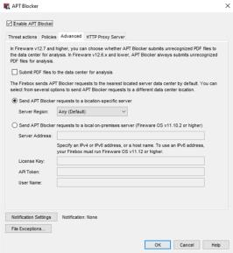
APT Blocker – Submit PDF Files for Analysis
You can now specify whether APT Blocker submits unrecognized PDF files to the data center for analysis, which gives you more granular control to address privacy concerns
By default, the check box is not selected and APT Blocker does not send unrecognized PDFs for analysis
  This is a change to the default behavior in previous versions
To send PDF files for analysis:
  Select Subscription Services > APT Blocker > Advanced tab
  Select the Submit PDF files to the data center for analysis check box
APT Blocker always submits the MD5 hash of PDF files to the data center and takes the specified action if the file matches any known threats

Slide 91
Configure Log rate Limits

Slide 92
Configure log rate limits
You can now control how many log messages the Firebox sends when it denies different types of traffic
By default, the Firebox sends three log messages a minute
In a large or busy network environment, it can be helpful to temporarily increase the limit to troubleshoot issues related to denied traffic
High rates of log message generation can impact Firebox performance

Slide 93
Configure Log Rate Limits ─ Policy Manager
In Policy Manager, you can configure log rate limits for Blocked Sites, Blocked Ports, and these Default Packet Handling categories:
  IP Spoofing Attacks
  Port Scan
  IP Scan
  IP Source Route
  IPSec, IKE, SYN, ICMP, UDP Flood Attacks
  DDOS Attack Destination
  DDOS Attack Source

Slide 94
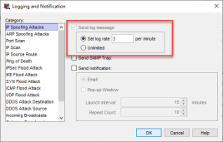
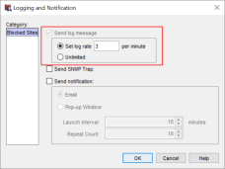
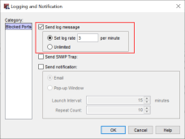
Configure Log Rate Limit ─ Policy Manager
To configure log rate limits in Policy Manager:
  Default Packet Handling – Select Setup > Default Threat Protection > Default Packet Handling > Logging, then select a Category
  Blocked Sites – Select Setup > Default Threat Protection > Blocked Sites > Logging
  Blocked Ports – Select Setup > Default Threat Protection > Blocked Ports > Logging
Select Set log rate and type the maximum number of messages to generate each minute, or select Unlimited

Slide 95
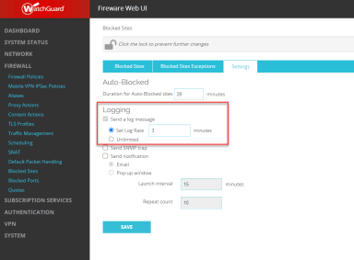
Configure Log Rate Limits ─ Web UI
To configure Blocked Sites log rate limits in Web UI:
  Select Firewall > Blocked Sites > Settings tab
  Select Set log rate and type the maximum number of messages to generate each minute, or select Unlimited
You cannot configure other log
rate limits in Web UI

Slide 96
Configure Log Rate Limits ─ CLI
In the Command Line Interface, you can use these commands to set different log rate limits:
  Blocked Sites – WG(config)#ip blocked-site notification log-message log-rate
  Blocked Ports – WG(config)#ip blocked-port notification log-message log-rate
  Default Packet Handling – WG(config)#default-packet-handling logging [category] log-rate
Specify a number from 1 to 2,000,000,000 (2 billion)
You cannot type the word Unlimited

Slide 97
Configure Log Rate Limits
Log rate limits apply to all logs of that type, regardless of the event that generates the log that reaches the limit
    Example: If you set the Blocked Ports log rate limit to 5, after the Firebox generates 5 Blocked Ports logs in a minute, it does not generate any more Blocked Ports logs until the next minute
The log rate limit you specify for Blocked Sites also applies to Geolocation logs

Slide 98
HTTPS Predefined Exceptions List automatic Updates

Slide 99
HTTPS Predefined Exceptions List Automatic Updates
The HTTPS exceptions list can now automatically update without a Fireware upgrade
In HTTPS proxy actions, the Content Inspection tab includes a new Automatically update HTTPS exception list check box
By default, this check box is selected and the HTTPS exceptions list updates automatically

Slide 100
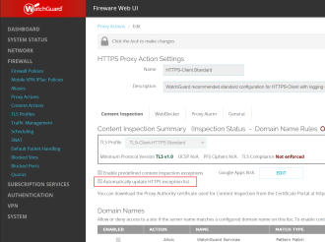
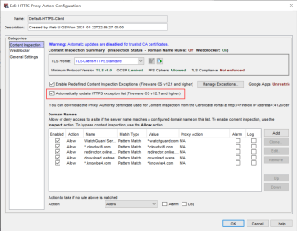
HTTPS Predefined Exceptions Automatic Updates
In Web UI, configure the new setting on the Content Inspection tab for an HTTPS proxy action
In Policy Manager, configure the new setting in the Content Inspection category for an HTTPS proxy action

Slide 101
FQDN Limits
Replaced by Warning

Slide 102
FQDN Limits Replaced by Warning
There is no longer a limit on the number of fully qualified domain names you can use in your Firebox configuration
The Firebox now generates a warning log message when you save a configuration that exceeds a specific number of fully qualified domain names
The number of fully qualified domain names that generates a warning depends on your device model:
  Firebox M270, M370, M400, M440, M470, M500, M570, M670, M4600, M5600, T55, T55-W, T70, FireboxV, and Firebox Cloud: 2048 domain names
  All other device models: 1024 domain names
Example log message:
  2020-12-17 16:28:01 wgagent The number of FQDNs exceeds the recommended maximum of 2048 Debug

Slide 103
Intra-Bridge Traffic Inspection

Slide 104
Intra-Bridge Traffic Inspection
You can now select to apply firewall policies to traffic that passes between bridge member interfaces, which is known as intra-bridge traffic
  The Firebox now inspects and logs this traffic
Configuration
  (Web UI) Select Network > Bridge
  (Policy Manager) Select Network > Configuration > Bridge
  Add or Edit a bridge configuration
  Select Apply firewall policies to intra-bridge traffic

Slide 105
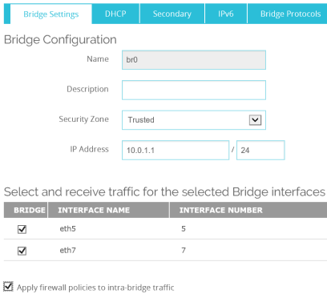
Intra-Bridge Traffic Inspection
Web UI

Slide 106
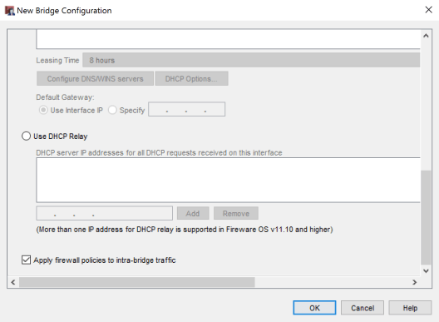
Intra-Bridge Traffic Inspection
Policy Manager

Slide 107
Intra-Bridge Traffic Inspection
Example
  Select the Apply firewall policies to intra-bridge traffic option
  Send ping traffic between hosts on different bridge member interfaces
  The Firebox does not allow the ping traffic
  Add a policy for the ping traffic
  Send ping traffic
  The Firebox allows and logs the ping traffic

Slide 108
Intra-Bridge Traffic Inspection
Log messages include the bridge name
  In this example, the Firebox allowed traffic between hosts on different member interfaces that belong to the bridge br0
Policy that matched this traffic
Bridge br0
Hosts on different interfaces that are members of br0

Slide 109
Intra-Bridge Traffic Inspection
When the Apply firewall policies to intra-bridge traffic option is not selected, the Firebox allows the traffic but does not inspect or log the traffic

Slide 110
Disable dns cache

Slide 111
Disable DNS Cache
For configurations with DNS Forwarding or DNSWatch enabled, you can now select an option in Fireware Web UI or Policy Manager to disable the DNS cache on the Firebox

Slide 112
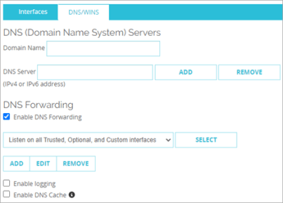
Disable DNS Cache
To disable the DNS cache, in Fireware Web UI:
  Select Network > Interfaces > DNS/WINS.
  Clear the Enable DNS Cache check box.

Slide 113
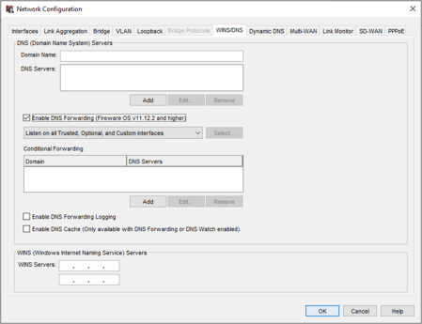
Disable DNS Cache
To disable the DNS cache, in Policy Manager:
  Select Network > Configuration > WINS/DNS.
  Clear the Enable DNS Cache check box.

Slide 114
Thank you

